Slide 1
Deportation Defense 101
Organized Communities Against Deportations
A part of the #Not1More Campaign
www.notonemoredeportation.com

Slide 2
What does deportation defense mean?
Help individuals in detention and their families get in touch with each other;
Connect people with legal services;
Strategize with attorneys and family members on ways to strengthen cases or pressure decision-makers;
Monitor ICE and identify patterns to guide our advocacy and intervention in policy;

Slide 3
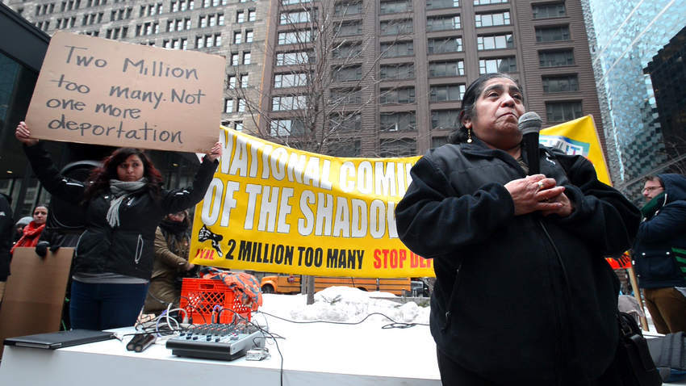
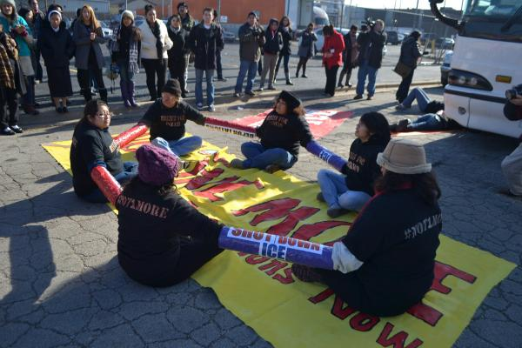

Slide 4
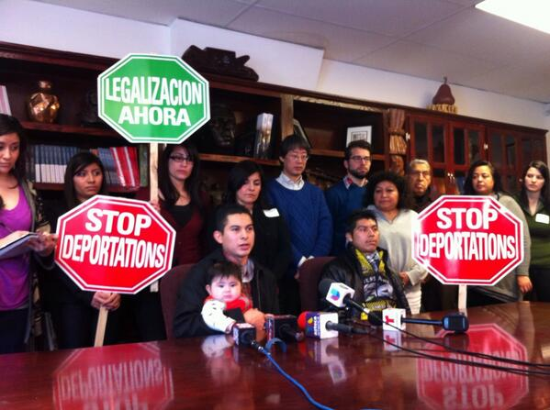

Slide 5
Who is deportable?
Legal permanent residents
People with Temporary Protected Status
People who qualify for Deferred Action for Childhood Arrivals (DACA)
People with visas
Undocumented
Basically anyone who is not a U.S. citizen!

Slide 6
Prosecutorial Discretion
Long standing concept in enforcement about prioritizing resources to target “high priority” individuals or crimes,
In immigration enforcement defined by memoranda, the most recent by DHS Secretary Jah Johnson,
Who is considered “priority” changes based on definitions, political environment, our organizing

Slide 7
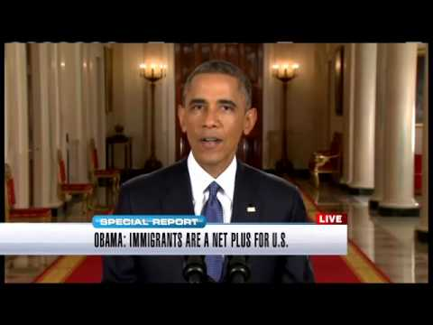
Maybe the President can explain it better
Notes:
Play 5:28-6:14

Slide 8
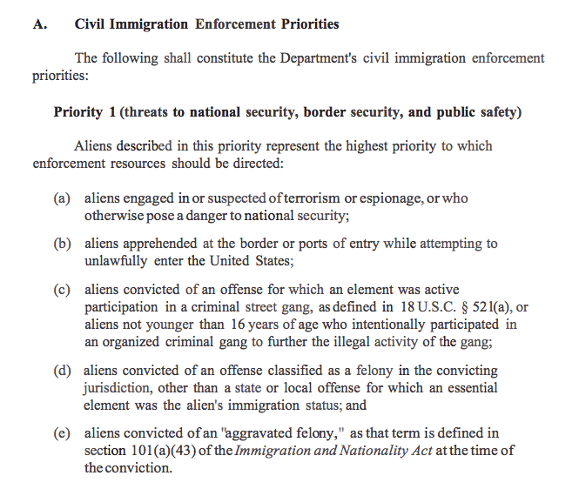
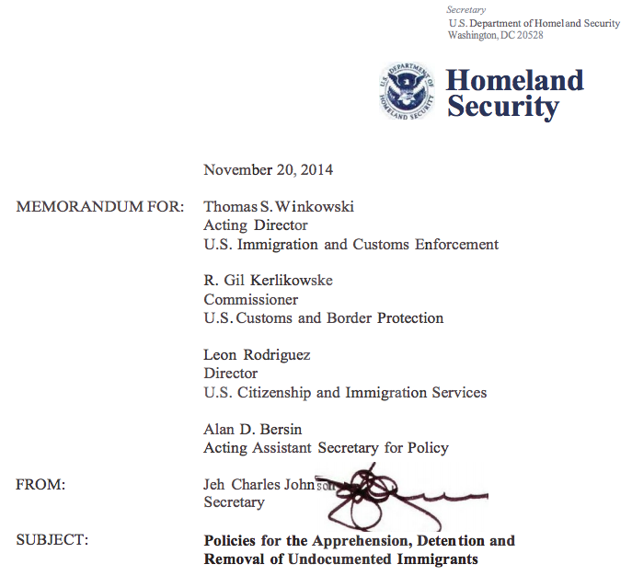
DHS Secretary Johnson’s November 20th 2014 Memorandum

Slide 9
A list of some of the priorities
Those arrested at the border or ports of entry while attempting to enter the U.S.
People with criminal convictions or felonies;
People convicted of certain misdemeanors categorized by immigration as “aggravated felonies,” such as theft, filing a false tax return and failing to appear in court;
People convicted of 3 or more misdemeanors;

Slide 10
Then there is the “significant misdemeanor,” which makes someone a priority and includes:
driving under the influence
domestic violence
burglary
drug distribution or trafficking
unlawful possession or use of a firearm
sexual abuse or exploitation
Notes:
Read all of them, and spend some time on the DUI, maybe if you want on the domestic violence. Just a few minutes on how we have been seeing more and more of these cases , and how they are affecting the community.

Slide 11
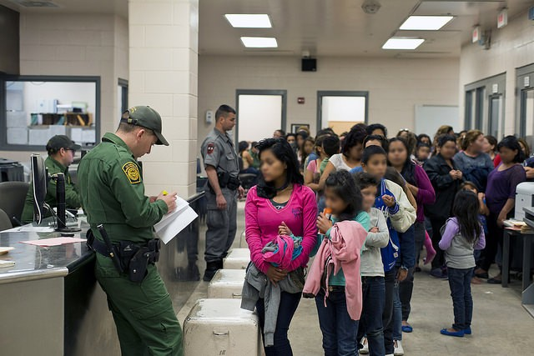
The last priority is those who have recently arrived, and have been issued a final deportation order on or after January 1, 2014

Slide 12
What do the “priorities” mean for our communities?

Slide 13
In March, ICE conducted operation crosscheck, detaining over 2,000 people with criminal convictions in their homes. Since 2011 five national Crosscheck ops have detained 13,214 immigrants.
“Of the total 2,059 criminals arrested, 58 are known gang members or affiliates, and 89 are convicted sex offenders. The vast majority of misdemeanor convictions were for driving under the influence of alcohol or drugs (DUI). ICE considers DUI offenders, particularly repeat offenders, to be a significant public safety threat. ”-- ICE PR

Slide 14
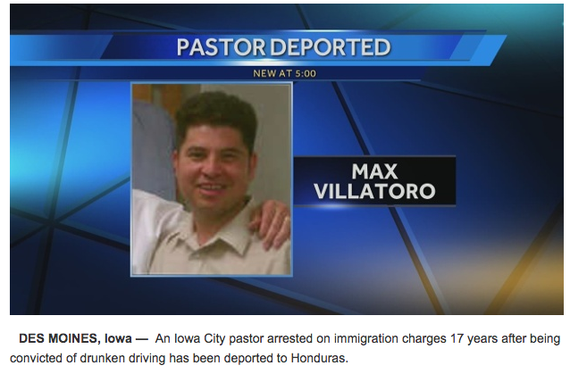

Slide 15
10 minute break!

Slide 16
How do we organize & support people in deportation proceedings?
Help individuals and family navigate and understand process;
Connect with legal support, and help make case stronger;
Help gather personal documents and support/ proof;
Support in framing of the story for the public & for ICE
Connect case to civil rights and policy issues;
Getting support from national (likely & unlikely) institutions;
Helping stop a deportation;
Physically interrupting a deportation;
Notes:
Do an intake for the person in detention with them and their families to help them understand their case.
Get in touch with the family to explain situation and their options
Connect them with legal support to evaluate their case

Slide 17
Scene 1: Get a call from the detention center from Pedro, who was not able to tell their family he was picked up by ICE on his way to work. He doesn’t know why he is being held.
Notes:
- Intake
- What information is useful for us? And Why?
- We are not attorneys, referrals are important
- follow the case.

Slide 18
Scene 2: Rita crossed the border when she was 14 years old by herself. She knows she missed her court, and is afraid ICE will come looking for her. She lived through violence in El Salvador, but has no documents to prove it.
Later her lawyer is able to re-open her court, and she has to present her case next month!
Notes:
intake
lawyer to figure out if court can be re-opened
Help her gather proof, testimonies from people in El Salvador, information about the country and her trauma
Show up to her court to support

Slide 19
Scene 3: Rosa was on her way home from a party when she was stopped at a DUI check-point in Little Village. Her alcohol level was above the limit, and she was eventually given a DUI and probation. Two weeks after her probation was over, ICE agents came to her house and detained her. She is now in detention. Her family came to ask for your help.
Notes:
intake, find out more information
Positive factors and messaging -- how do we frame the DUI

Slide 20
Case Strategy Practice:
How do you make the case stronger?
What sort of public messaging or frame will you use for the case? [What’s the headline?]
Who are your allies, likely and unlikely?
What strategies can you use to stop their deportation?

Slide 21
How will you participate in deportation defense?
Intakes
Attend Asamblea/OCAD meetings
Sign a petition, make a call, multiply
attend future workshops
detention hotline volunteer
work with people in detention and their families; translate documents
be on call for events; court support; conferences
create flyers, outreach, data collection at courts & detention centers
interested in organizing around local DUI checkpoints?
help families fundraise for their case expenses
follow-up calls after workshops, meetings
organizational resources to support anti-deportation work
assist with legislative tracking at state and local level; legislative training
any other ways you or your organization can support?

Slide 22
Big picture -- Leverage and changing policies, implementation practice and structures.

