Slide 1
How do I apply for a u Visa?
Esperanza Immigrant Rights Project

Slide 2
What is a u Visa?

Slide 3
Introduction
Definition: U Visa is a legal immigration status for victims of certain crimes who collaborate with the authorities in the investigation or prosecution of the crime.
Distributed at the discretion of USCIS
10,000 limit every year

Slide 4
What are the Benefits?
The U Visa is a legal status.
It lasts 4 years.
After 3 years, you are eligible for permanent residence status.
Given authorization for work and social security.
Some relatives may be included in the application.
Victims of crime in the United States who have returned to their country of origin may still be eligible in some cases.

Slide 5
How does the visa affect your case in Immigration Court?
U Visa is decided by USCIS and is not decided in court.
If you have a hearing, you may tell the judge that you are waiting for a decision on your U Visa application.
It is not necessary to finish the process in immigration court to apply for a U Visa.

Slide 6
How does the visa affect your case in Immigration Court?
You may request a continuance or to be placed on the status docket:
Continuance:
Sometimes the judge does not close the case, but they give a continuance while USCIS processes your U Visa application.
You’re asking the judge to continue your hearing to another date. That request may or may not be granted.
How long they push your hearing depends on the judge.

Slide 7
How does the visa affect your case in Immigration Court?
You may request a continuance or to be placed on the status docket:
Status docket:
Special calendar for cases the have applications with other courts or agencies.
On this calendar, it may take approximately 1 year to see the judge again.
You will be requested to provide the current status of your USCIS application for review.

Slide 8
U visa eligibility

Slide 9
Eligibility: Who can Obtain a U Visa?
Direct victims of a crime
Indirect victims of a crime
Derivative family members

Slide 10
Requirements
Direct or indirect victim of a crime that occurred in the United States
Crime was an eligible criminal activity
You were injured because of the crime; and
You helped, are helping, or there is a likelihood that you will help, in the investigation or prosecution of the crime

Slide 11
Requirement 1:
You were the direct or indirect victim of a crime.
The crime occurred within the United States.

Slide 12
Direct or Indirect Victim
Direct: you directly suffered the harm.
Indirect: if the direct victim was a victim of murder or involuntary manslaughter, or is incapacitated or is incapacitated as a result of the crime, then the following family members may qualify as an indirect victim:
Husband,
Single children under 21 years of age
Parents, if the victim was under 21 years of age, and
Brothers under the age of 18, if the victim was under 21 years of age

Slide 13
Requirement 2:
Eligible Criminal Activities:
Examples:
Harassment, felony assault, murder, sexual exploitation, extortion, involuntary manslaughter, prostitution, kidnapping, torture and domestic violence.
Attempt or conspiracy to commit one of these crimes.
Similar crimes (comparison)

Slide 14
Requirement 3:
Suffered substantial harm resulting from being a victim:
You must have suffered physical or mental harm, or both.
It does not matter if the damage occurs in only one event or over a period of time.

Slide 15
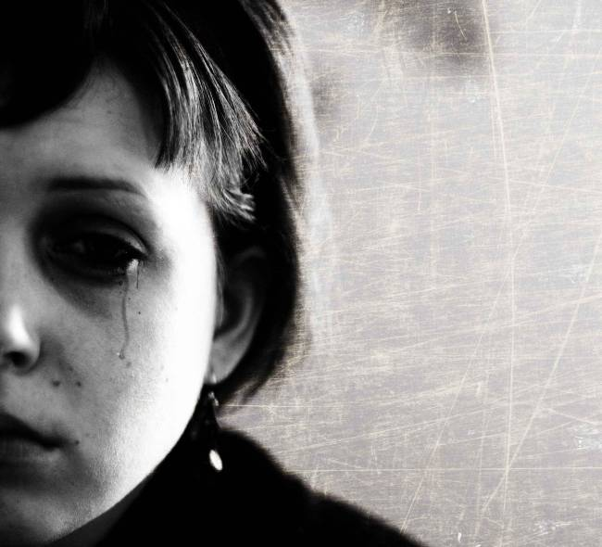
Examples: Physical or Emotional Harm
Did you have pain?
Did you have to consult a doctor?
Did you have to consult a therapist?
Are you still hurt or sore?

Slide 16
Requirement 4:
You must have helped the authorities.
At minimum, you reported the crime to the police.
To obtain a U Visa, the authorities have to confirm that you provided assistance. (I-918 Supplement B)
If they ask for your help in the case, you must to help them.

Slide 17
How To apply for a u visa

Slide 18
Forms: Necessary Documents
Police Report
I-918 (principal form)
I-918 A
I-918 B
I-765
I-192
Personal Declaration
Letters of Support
Identification documents

Slide 19
Necessary Forms: I-918 A
Petition for your family members
You can submit it at the same time as the main application
If the principal is under 21 years of age, you can request:
Spouse
Children
Parents
Siblings under 18 years old
If the principal is over 21 years old, you can request:
Spouse
Children (under 21 years old)

Slide 20
Necessary Forms: I-918 A
Each family member that is included in the application needs an I-918A
Form I-918A asks about:
Biographical information
Spouse, children
Address and phone number
Immigration History
Crimes

Slide 21
Necessary Forms: I-918 B
Prove that you helped the police or the authorities
If you do not have the Supplement B completed and signed, you are not eligible for U Visa
The police, a prosecutor, a judge, or an officer can sign the Supplement B
Each department or agency has different steps for certification
Discretion of each agency
Lasts only 6 months

Slide 22
Necessary Forms: I-765
Application for employment authorization
Include two passport style photos
All family members who are included in the application must send their own I-765

Slide 23
Necessary Forms: I-192
Application for a waiver
If you have committed a violation of immigration laws, or a criminal violation, you will need this waiver
You have to ask the government for this waiver to qualify for a U visa and to stay in the United States

Slide 24
Why do you Need a Waiver?
Reasons for forgiveness:
Necessary if you have violated any immigration law
Entered the United States without inspection
Present in the United States without documents or without parole
Have a final deportation order
Necessary if you have committed a crime
Multiple criminal convictions
Drug offenses

Slide 25
Personal Declaration
Your story written in you own words:
About yourself. Who are you?
About the crime you suffered: What happened? What was the damage and how did you help the police?
If you have committed a crime: About the crimes and how you have changed (if you had to attend classes, etc.)
Waiver: the reason why you deserve a waiver

Slide 26
Other Important Documents:
Other evidence of the crime and that you helped the police
Letters of support
Letters from doctors and mental health therapists
Information about your criminal history
Form I-912

Slide 27
Evidence of the Crime and that you Helped the Police
Police report and court records
Protection orders
Call register to 911
Photos of your wounds
Newspaper articles that describe the crime

Slide 28
Letters of Support
On the part of: supervisors, church clergy, neighbors, friends, relatives, your children’s teachers
Prove that you are a good person or good parent to your children
If this person has information about the crime or the harm you suffered, it could be important

Slide 29
Evidence of Harmed Suffered
Medical records from hospitals and clinics
Letters from doctors or mental health professionals
Information about how you suffered physical and psychological harm

Slide 30
Form I-912
Forms I-192 and I-765 cost a lot of money. If you cannot afford to pay, you can apply for a fee waiver.
If they approve fee waiver, the waiver applies to your children and spouse who are included in the application

Slide 31
Cover Letter
A letter to the government (USCIS) that is sent with your application
Explain who you are and that you are applying for a U Visa

Slide 32
The Next steps in order to apply for a U VISA

Slide 33
Next Steps: Now What?
Get the police report.
Get your I-918 Supplement B signed.
Complete the form: I-918
Complete the form: I-918 A
Complete the waiver form: I-192
Complete the form: I-765
Write your personal statement.
Obtain additional documents to support your case.

Slide 34
Important: Remember
All forms are free on uscis.gov
Get your documents translated into English.
Collect all your documents.
Send in your application:
USCIS Vermont Service Center
75 Lower Welden St.
Albans, VT 05479-001

Slide 35
What Happens Once you Mail your Application?
You will receive a notification that USCIS received your request.
You will receive the appointment to take your fingerprints.
Deferred Action. *
You will receive your work permit. *
Visa approval.*
* This may take years to attain.

